Slide 1


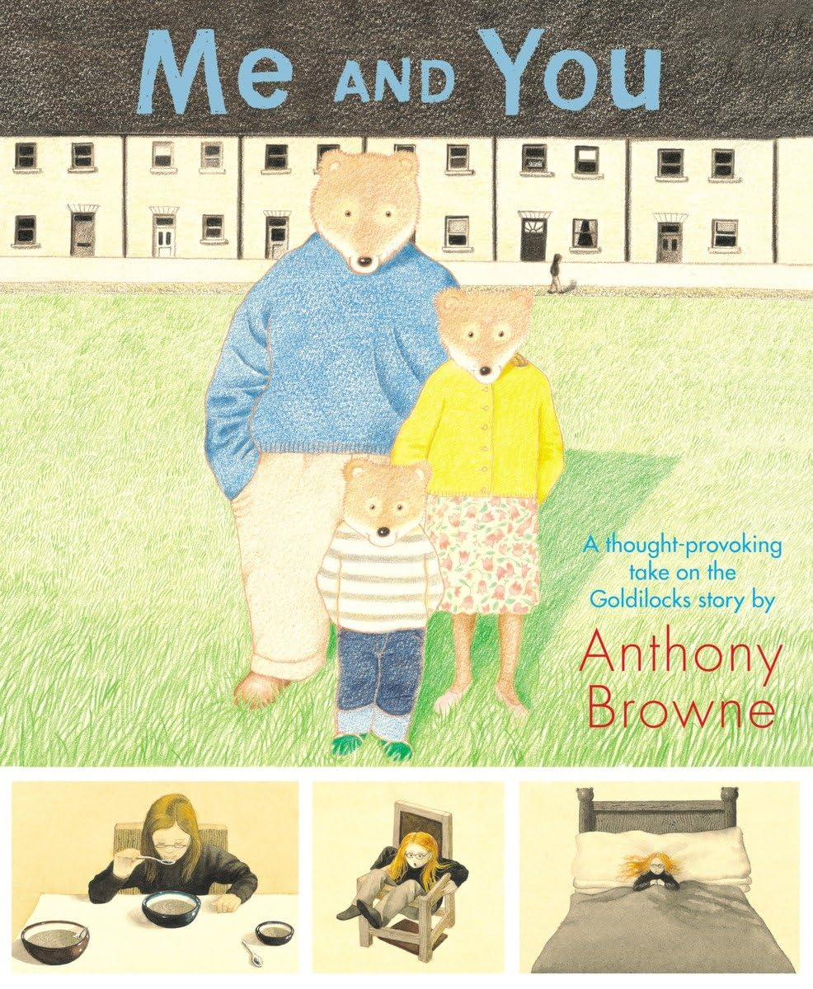
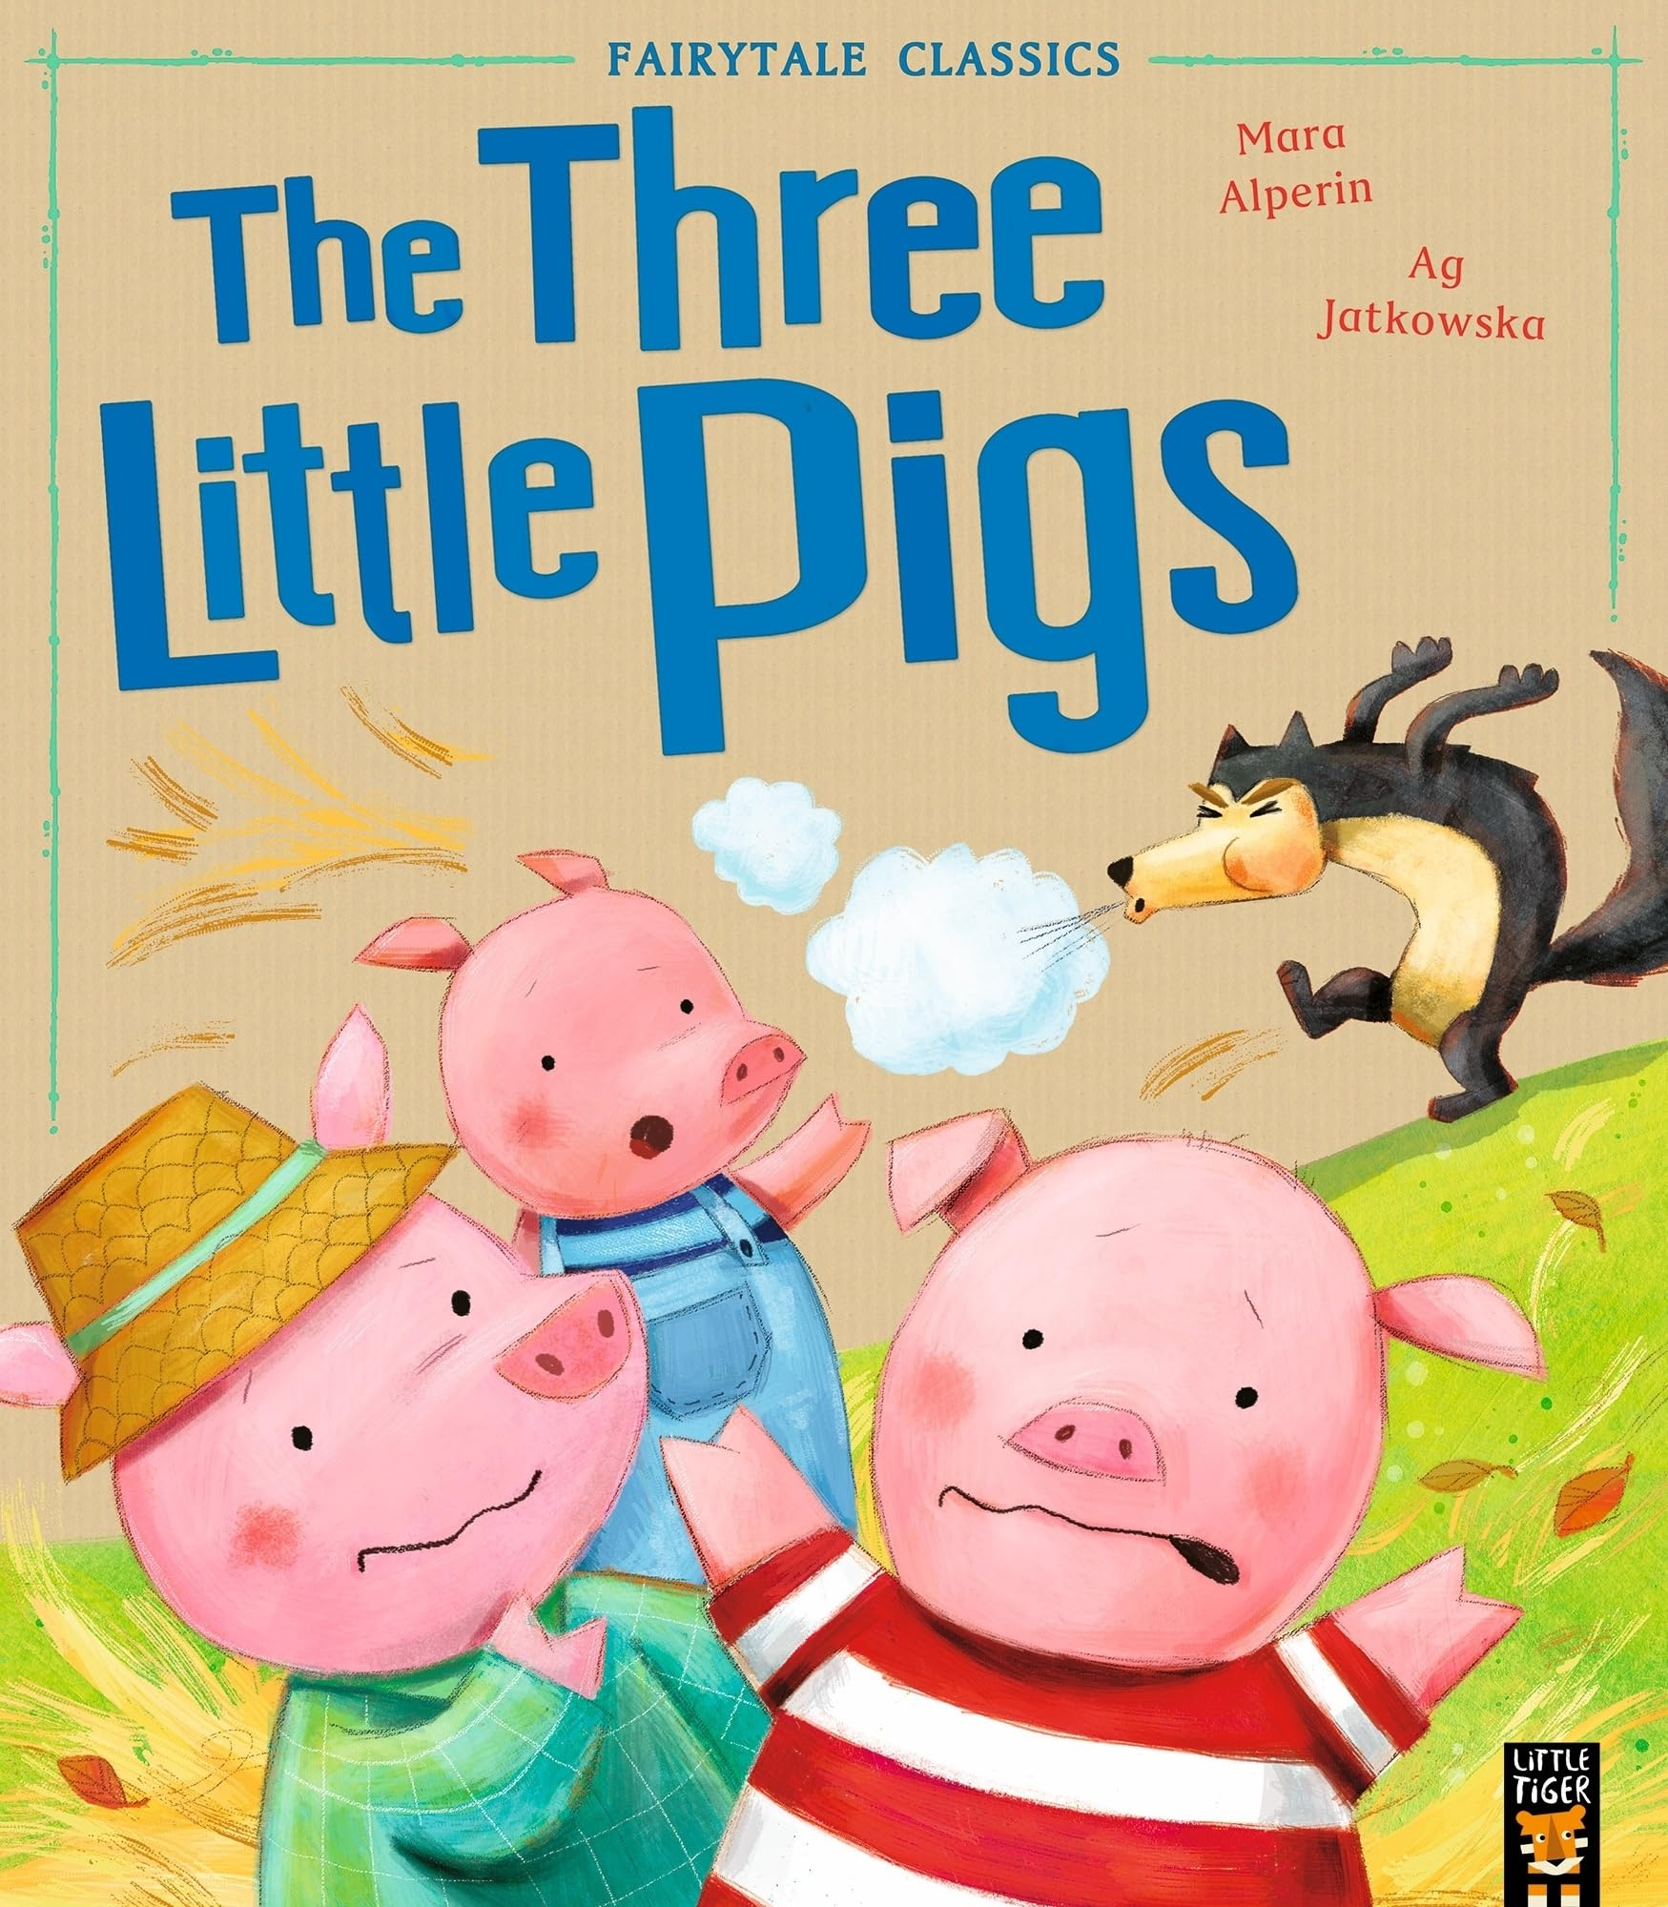
Year 2 – Autumn 1
Phonics and reading:
Recall and retell familiar stories
Sequencing events in order
Understand a characters personality, their feelings and actions within a story
Identify unfamiliar words, discuss their meanings and use new vocabulary
Make some inferences about characters and events and predict what might happen next
Answer questions about a text and understand key information from what has been read
Writing:
Creating our own traditional tales
Designing our own characters and settings
Using adjectives to enhance our sentences
Using capital letters and full stops in our sentences
Creating a fact file about schools in the past
Our Class texts:
Science: The uses of everyday materials
History: How was school different in the past?
PSHE: Family and relationships
RE: How can we make good choices?
Computing: Computing systems and networks – IT around us
DT: Structures – Creating baby bears chair from Goldilocks
Music: Tony Chestnut
Maths
We are learning:
Composition of multiples of ten
Counting and representing numbers from 20 to 99
Comparing, ordering and partitioning 2-digit numbers
Fluency of addition and subtraction facts within 10
Calculating within 20

