Slide 1

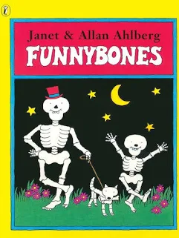
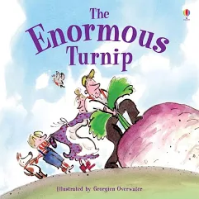



YEAR 1: Autumn 1
English/Writing Key texts
Funny Bones
The enormous Turnip
My family, Your Family
We are learning to explore the books physically, acting out and recreating aspects of the story. We are also learning to explore what happens next by sequencing, building upon prior knowledge and through prediction. We are learning to build simple sentences, remembering to use our finger spaces, capital letters and full stops creating simple reports and retelling the story. We will incorporate our phonics to build sentences and words. We will continue to build confidence in our hand writing through daily practice.
Animals, including humans - All about me
Science – Animals, including humans - All about me
History –How am I making history?
PE – Ball Skills
Fundamentals
Music - Menu song
Computing - Computing systems and networks
Technology around us
PSHE –My healthy self: How can we look after our emotions?
RE –How do Hindu stories help believers live their lives?
Art- Drawing: Exploring line and shape
Maths
We are learning to:
Recognising and comparing numbers 0 – 10
Count to and from 20
Count in tens - decade numbers
Exploring pattern in counting from 20 to 100

